Slide 1
Image classification using Dual-Stream CNN
A Hybrid Approach Combining Spatial (RGB) and Frequency (FFT) Analysis
Student Names: Orel Cohen 214266819, Hen Mandelbaum 209533587
Course: Deep Learning Date: February 2026

Slide 2
Project Overview & Mission
Mission: To develop a robust Deep Learning system capable of distinguishing between Real image vs 2D vs 3D image.
The Challenge: Advancements in Generative AI and 3D Rendering Engines create hyper-realistic fakes that are often indistinguishable to the human eye.
Our Solution: that categorizes images into three distinct classes:
1. REAL
2. 2D
3. 3D

Slide 3
Motivation & Use Cases
While traditional AI excels at object detection, it often fails to distinguish between different creation modalities like photographs, drawings, and 3D renders.
Our project addresses this gap by leveraging visual and spectral analysis to automatically classify images into Real, 2D, and 3D categories.
This solution is essential for Automated Dataset Curation, ensuring high-quality training data, and for enabling efficient style-based organization in Digital Asset Management systems.

Slide 4
The Dataset (3,000 Images)
- Balanced Dataset (1,000 per class):
Class 0: REAL (1,000 images)
Class 1: 2D (1,000 images)
Class 2: 3D CGI (1,000 images)
- Preprocessing: Crop, Resize to 224x224, Normalization.

Slide 5
Methodology: Dual-Stream Architecture
We don't just look at pixels; we look at signal frequencies
Spatial Stream (RGB): Analyzes visual textures (Skin, Eyes). Uses EfficientNet-B0
Frequency Stream (FFT): Converts image to frequency domain to find hidden artifacts. Uses ResNet18

Slide 6
System Block Diagram
Model Backbone: EfficientNet-B0
Core Architecture: Utilizes a pre-trained EfficientNet-B0 (trained on ImageNet) as the primary feature extractor.
EfficientNet Optimized for high accuracy with lower computational cost, capable of detecting subtle texture anomalies (e.g., pixel noise vs. smooth render) that distinguish Real from 3D.
Implementation Pipeline:
Input: RGB Images resized to 224×224 and normalized.
Custom Head: The original classifier was replaced with a Fully Connected Layer outputting 3 classes (Real, 2D, 3D).
Training: Fine-tuning performed using CrossEntropyLoss and Adam Optimizer (LR=0.001) to adapt the model to specific stylistic features.

Slide 7

Architecture Design Details
- Model A: EfficientNet-B0 (Pre-trained on ImageNet).
- Model B: ResNet18 (Optimized for patterns).
- Fusion Head: Concatenates features (1280 + 512).
- Classifier: Fully Connected Layers with Dropout (0.3) to prevent overfitting.

Slide 8
The FFT Algorithm
(Frequency Analysis)
How we detect the invisible:
1. Convert to Grayscale.
2. Apply 2D Fast Fourier Transform (FFT).
3. Logarithmic Scale & Shift to visualize low-magnitude frequencies.
4. Shift the zero-frequency component to the center
Result: A spectral image where fake images show distinct geometric patterns.

Slide 9
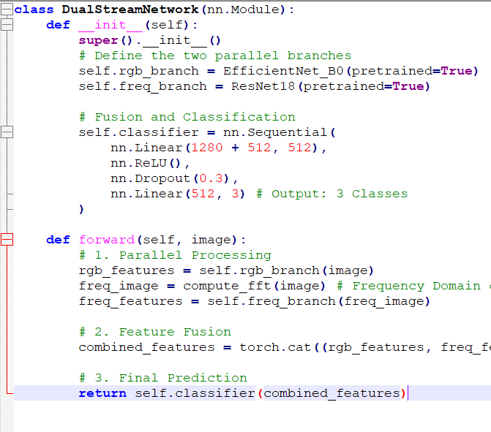
Python Pseudo-Code

Slide 10
Training Process
- Framework: PyTorch.
- Loss Function: CrossEntropyLoss.
- Optimizer: Adam (LR = 0.0001).
- Batch Size: 15.
- Epochs: 10.
- Hardware: GPU Acceleration.

Slide 11

Results & Performance
- Total Accuracy: 99% on Test Set.
- Precision & Recall: 0.99 for all classes.
- Confusion Matrix Analysis:
- 2D Detection: 995/1000 detected.
- Real Detection: 998/1000 detected (only 2 errors).
Total Errors: Only 7 out of 3,000 images.

Slide 12
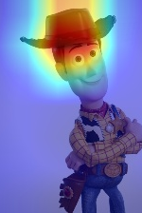
Explainability (Grad-CAM)
Analysis:
In Real Images: The model focuses on organic details like eyes, hair, and skin texture irregularities.
In Fake Images: The model targets overly smooth areas, rendering artifacts, and unnatural blending, confirming it is not "memorizing" background noise but learning relevant features.
.

Slide 13
Conclusion & Future Work
Conclusion:
We successfully developed a Dual-Stream CNN that solves the problem of art style detection with near-perfect accuracy.
The combination of Visual (RGB) and Spectral (FFT) analysis proved to be superior to single-stream methods.
Future Work:
Real-time Video: Expanding the model to process video frames in real-time.
Temporal Analysis: Adding a temporal dimension (RNN/LSTM) to detect inconsistencies across video frames (e.g., blinking patterns).
Mobile Deployment: Optimizing the model size for edge devices.

Slide 14

Source Code
Full project available at:
https://github.com/OrelCohenTech/ImageClassification
Repository Contents:
src/: Full source code (Training, Inference, Evaluation).
data/: Data loading and preprocessing scripts.
models/: Saved pre-trained weights (.pth).
README.md: Comprehensive documentation and installation guide.

